Slide 1
T-20 DATA ANALYSIS
Sivasree Manogar

Slide 2
Batting Performance Analysis, Bowling Performance Analysis
And Match & Team Performance Analysis

Slide 3


Which batsman scored the highest runs in a match?

Slide 4
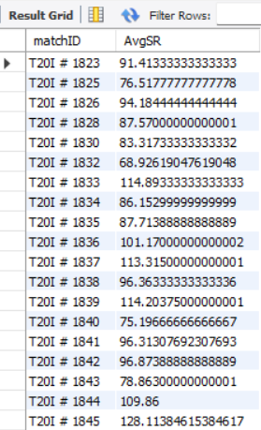

What is the average strike rate of batsmen in a given match?

Slide 5
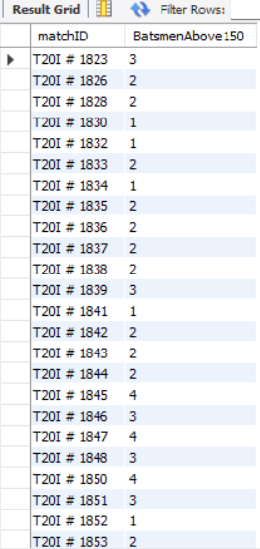
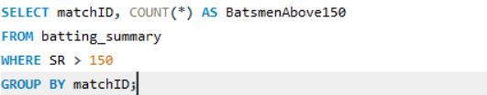
How many batsmen had a strike rate above 150 in a match?

Slide 6
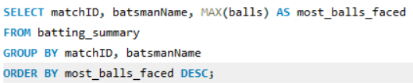

Who faced the most number of balls in a single match?

Slide 7
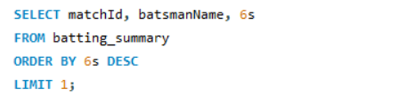

Which batsman hit the most sixes in a match?

Slide 8
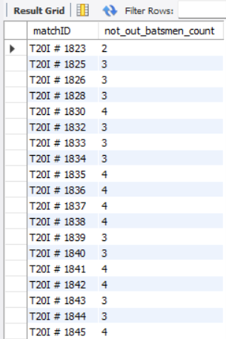
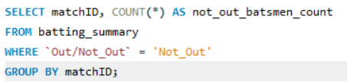
How many batsmen remained not out in a match?

Slide 9
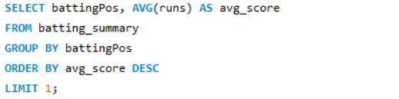

Which batting position had the highest average score?

Slide 10
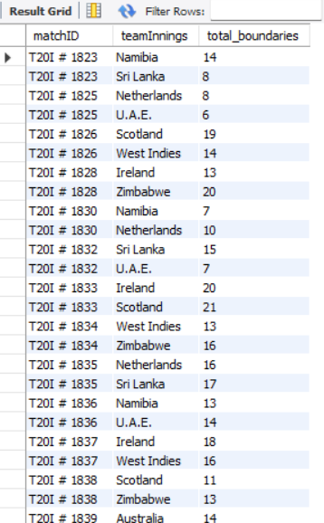

What is the total number of boundaries (fours and sixes) hit by each team in a match?

Slide 11
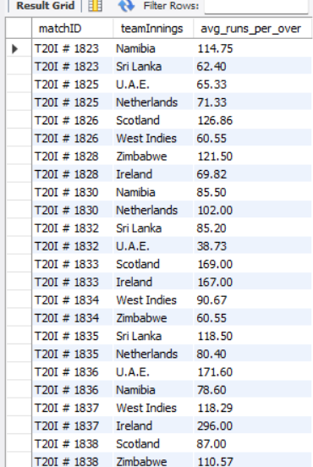

What is the average runs per over for a team in a given match?

Slide 12
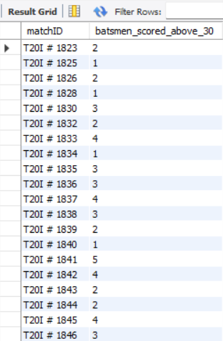
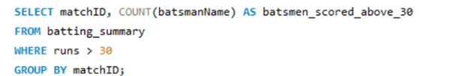
How many batsmen scored more than 30 runs in a single match?

Slide 13
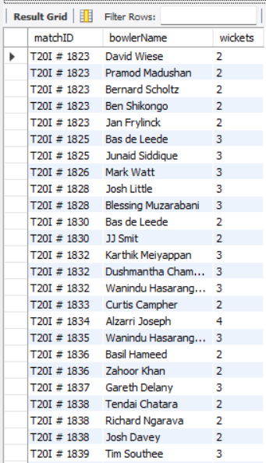
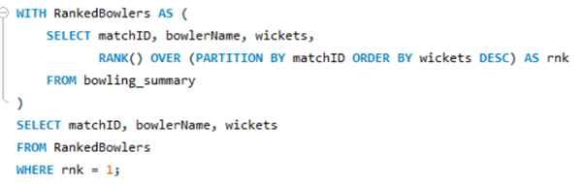
Which bowler took the most wickets in a match?

Slide 14
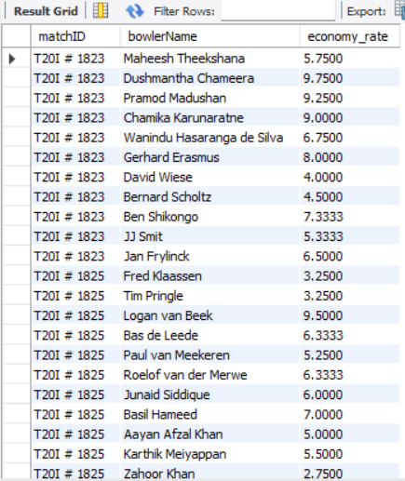

What is the economy rate of each bowler in a match?

Slide 15

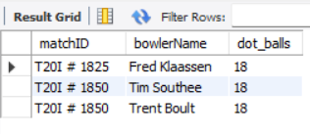
Which bowler bowled the highest number of dot balls in a match?

Slide 16
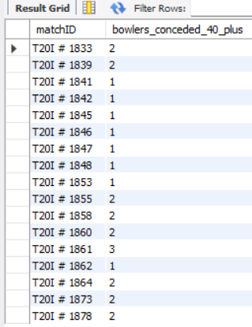
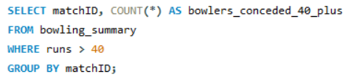
How many bowlers conceded more than 40 runs in a match?

Slide 17
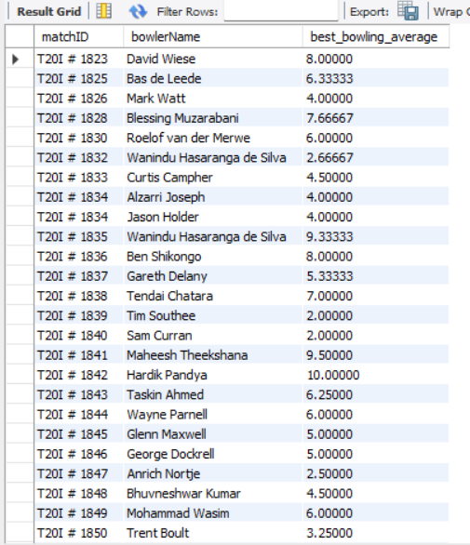
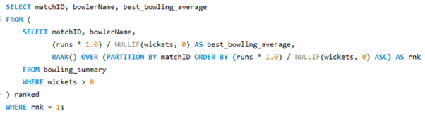
Which bowler had the best bowling average in a
match?

Slide 18
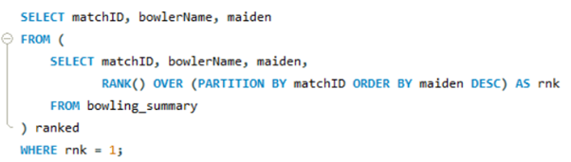

Who bowled the most maiden overs in a match?

Slide 19
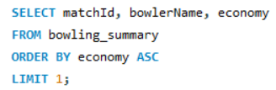

Which bowler had the lowest economy rate in a match?

Slide 20
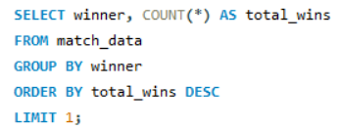

Which team won the most matches in a given tournament?

Slide 21
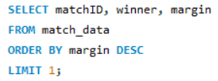

What is the highest margin of victory in the dataset?

Slide 22


How many matches were won by a margin of fewer than 10 runs or 2 wickets?

